Slide 1
Azure Stream Analytics
Iot Hub > Azure Stream Analytics Jobs > Storage /PowerBi

Slide 2
Important
In ASA (Azure Stream Analytics), live stream data is captured through Iot Hub, Event Hub or ADLS Gen2
Then it goes through ASA then after which it can be stored in storage
OR the data can be open in PowerBi in charts or whatever we want.

Slide 3
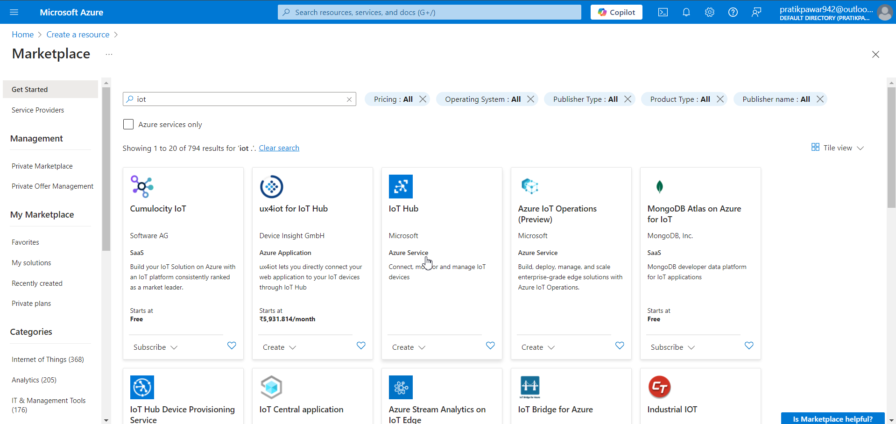
Go to IoT hub

Slide 4
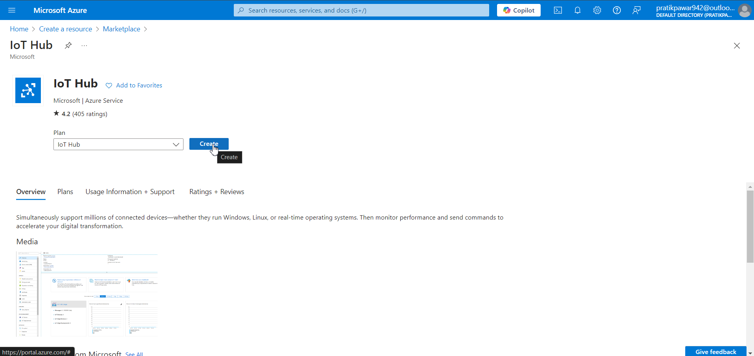
Create

Slide 5
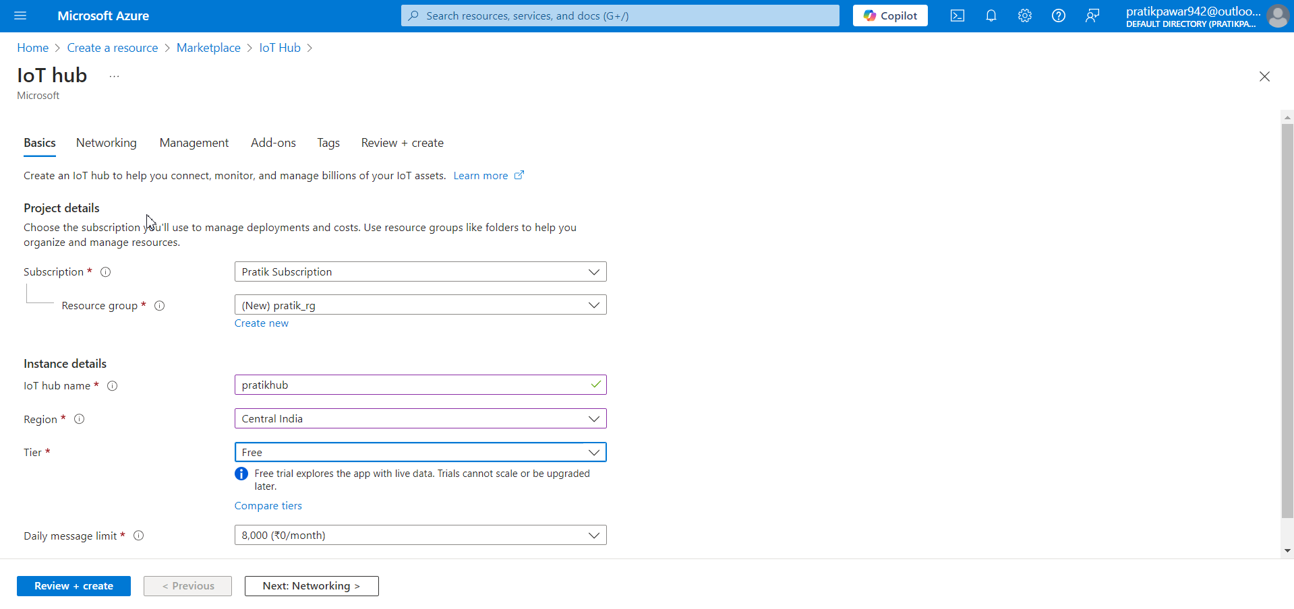
Fill Basics ( According to Requirement)

Slide 6
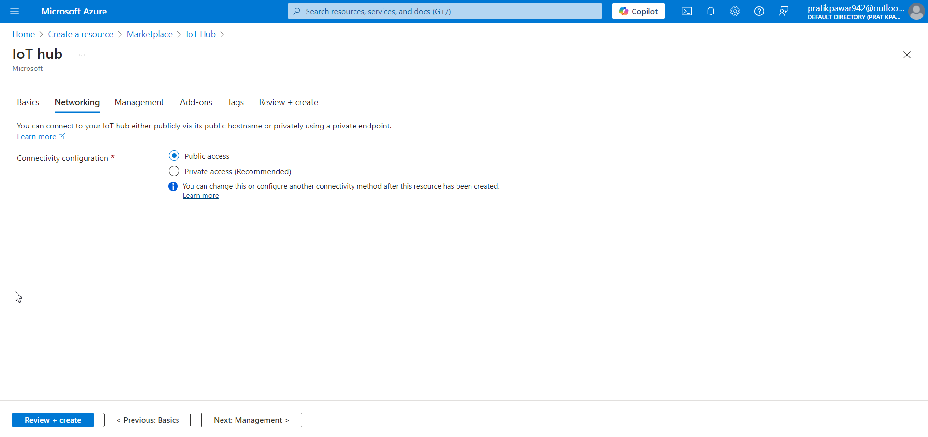
Networking

Slide 7
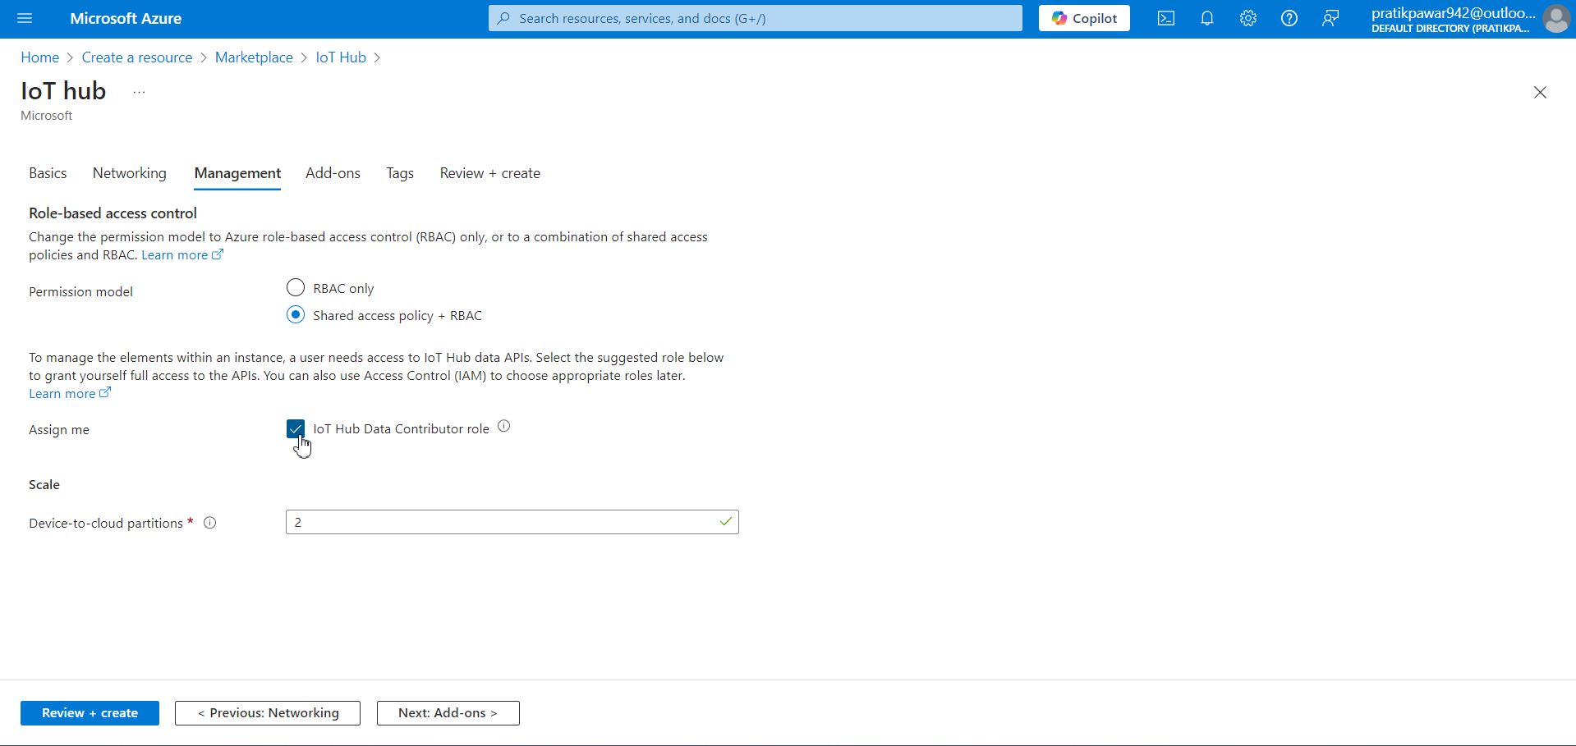
Management

Slide 8
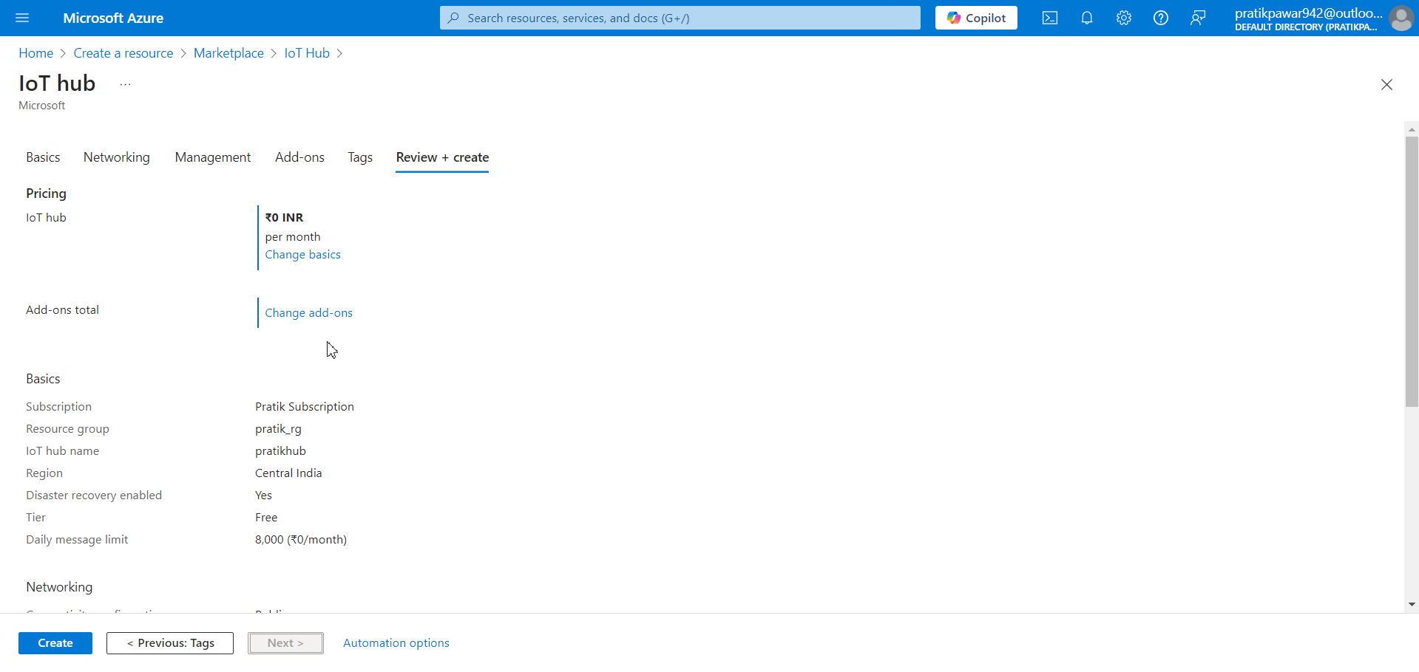
Create

Slide 9
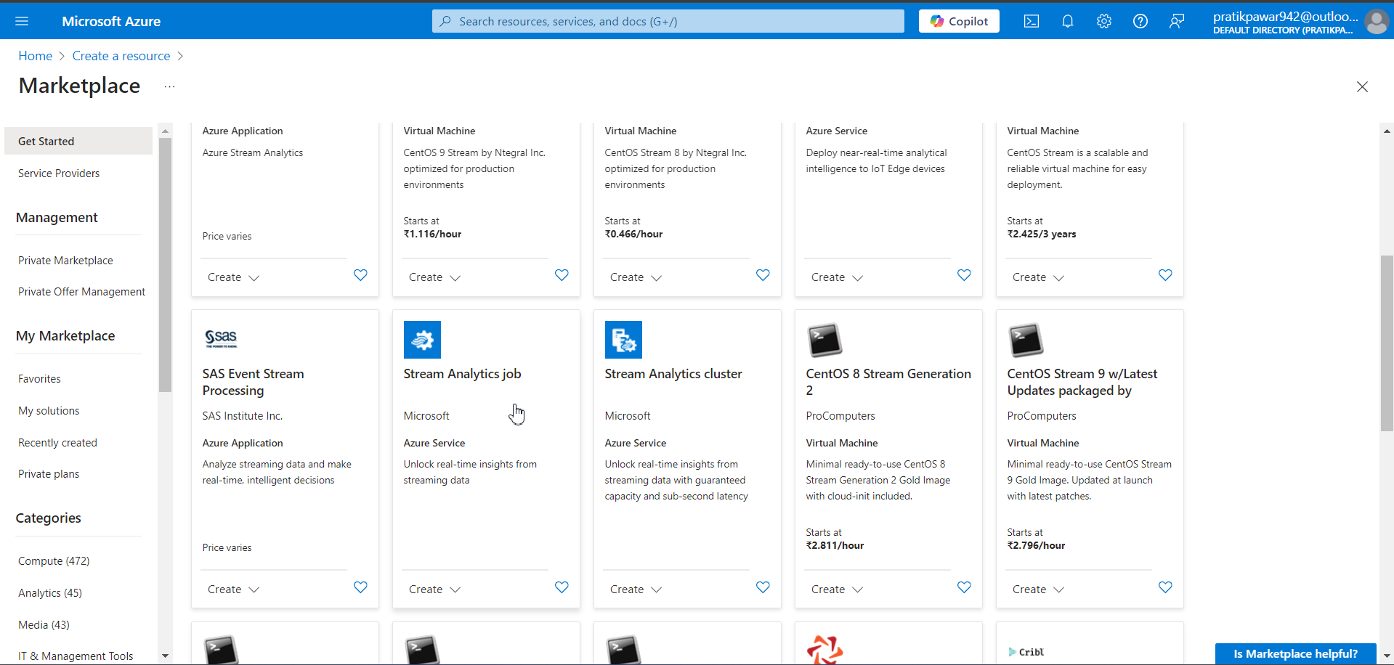
Now will make stream Analytics

Slide 10
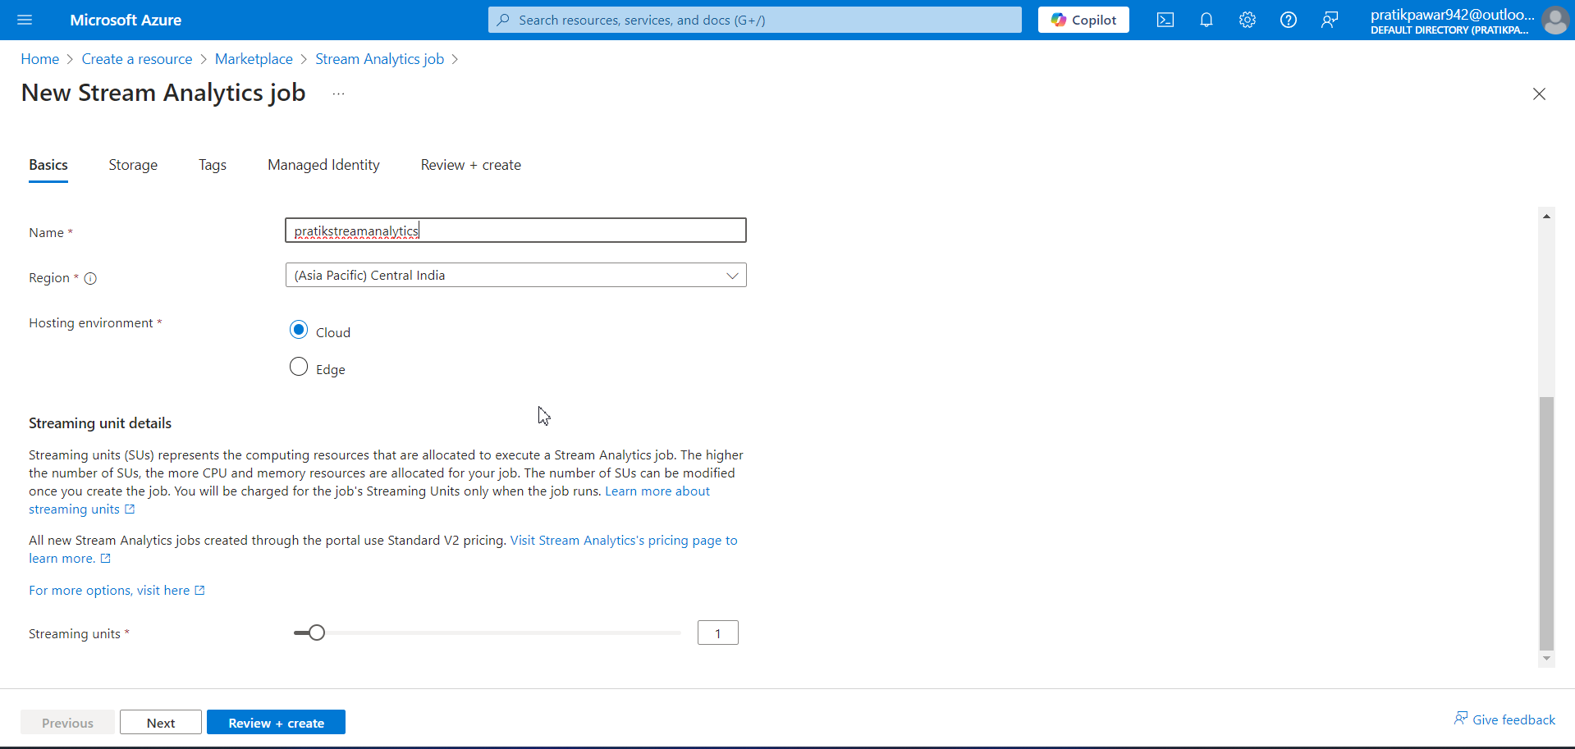
Fill basics according to requirement

Slide 11
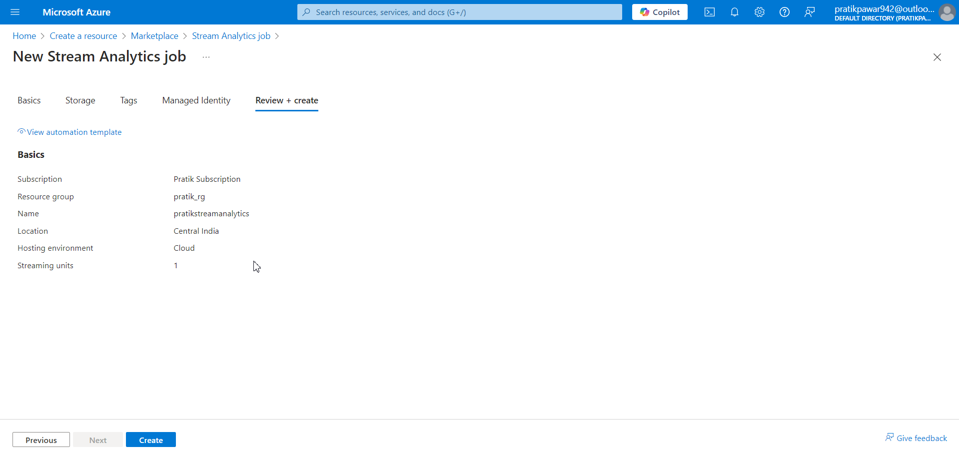
Create

Slide 12
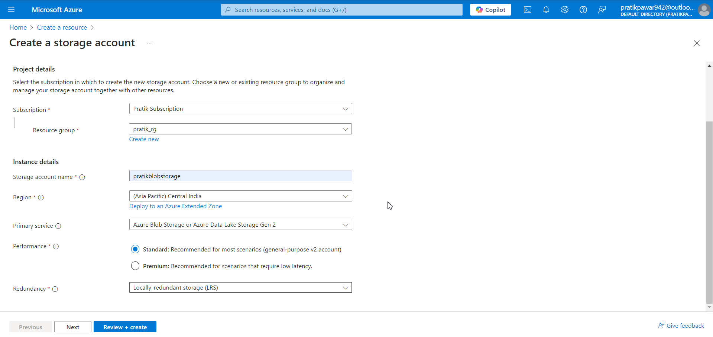
Now will create Blob Storage for outputdata

Slide 13
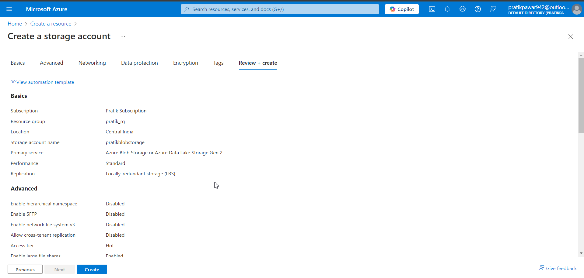
Create

Slide 14
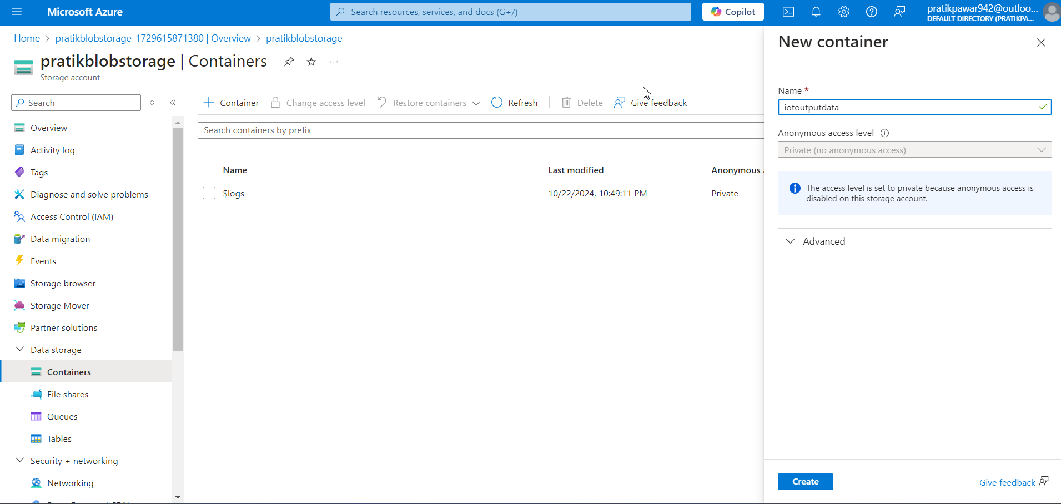
Create Container ‘ IoT Output Data’

Slide 15
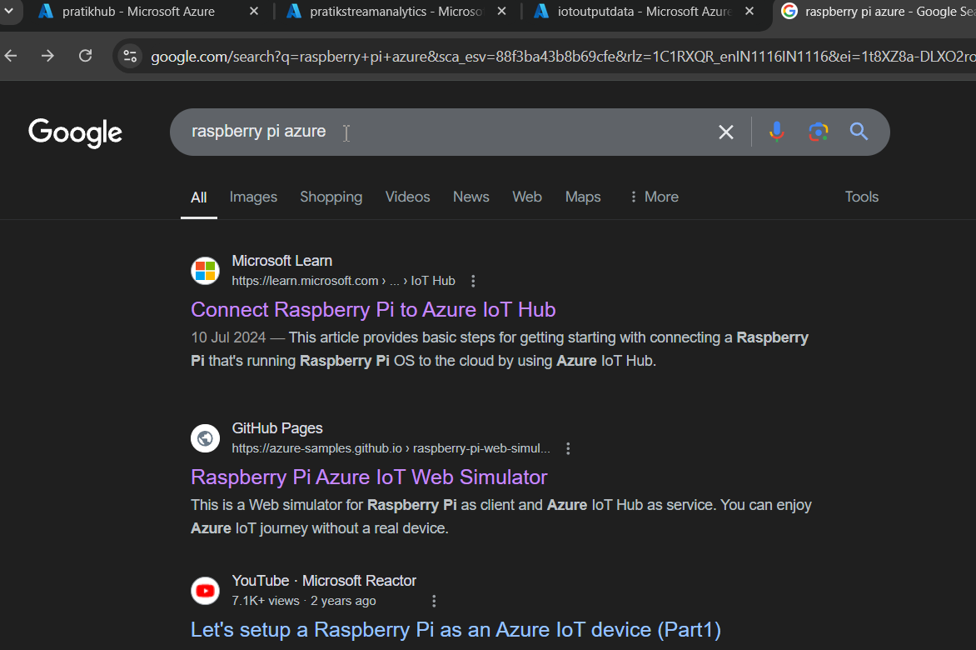
Now search ‘Raspberry pi azure’ on Google

Slide 16
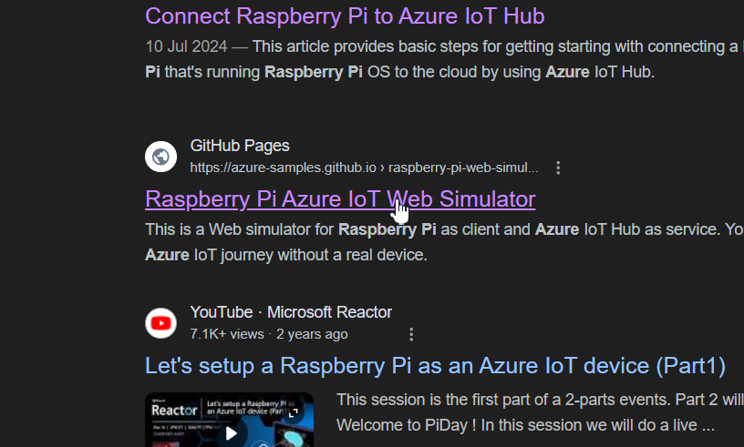
Open this site

Slide 17
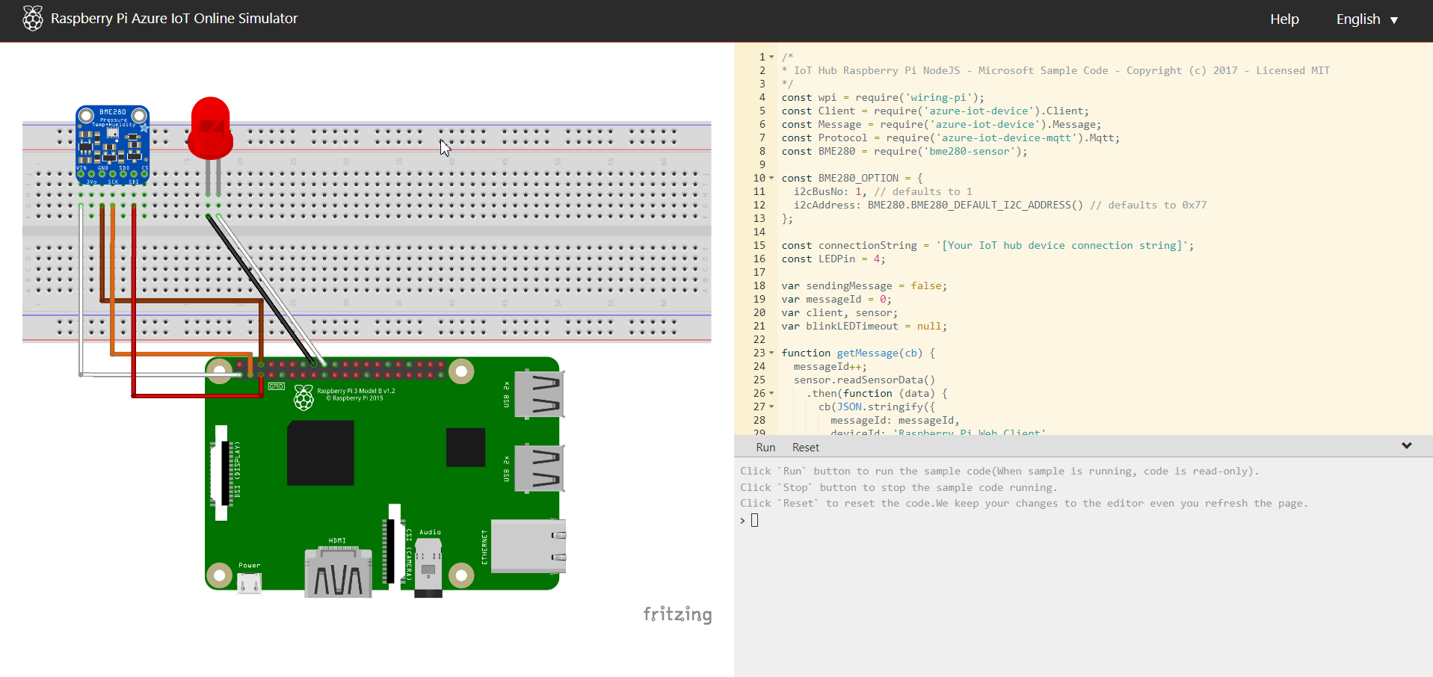
This is like a simulator of generating live streaming data for practice purpose. It gives temperature and humidity data streaming data. Now we have to add this device in Iot Hub

Slide 18
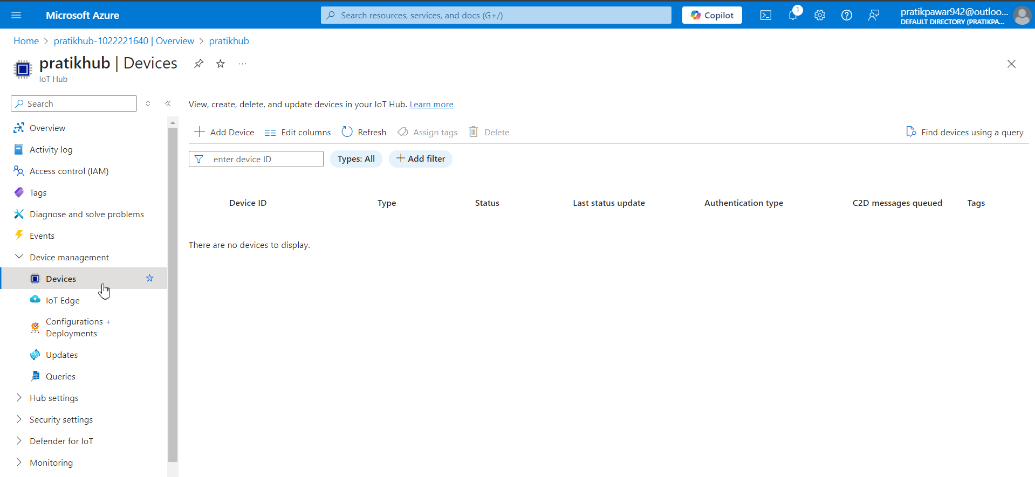
Go to Device management > Devices

Slide 19
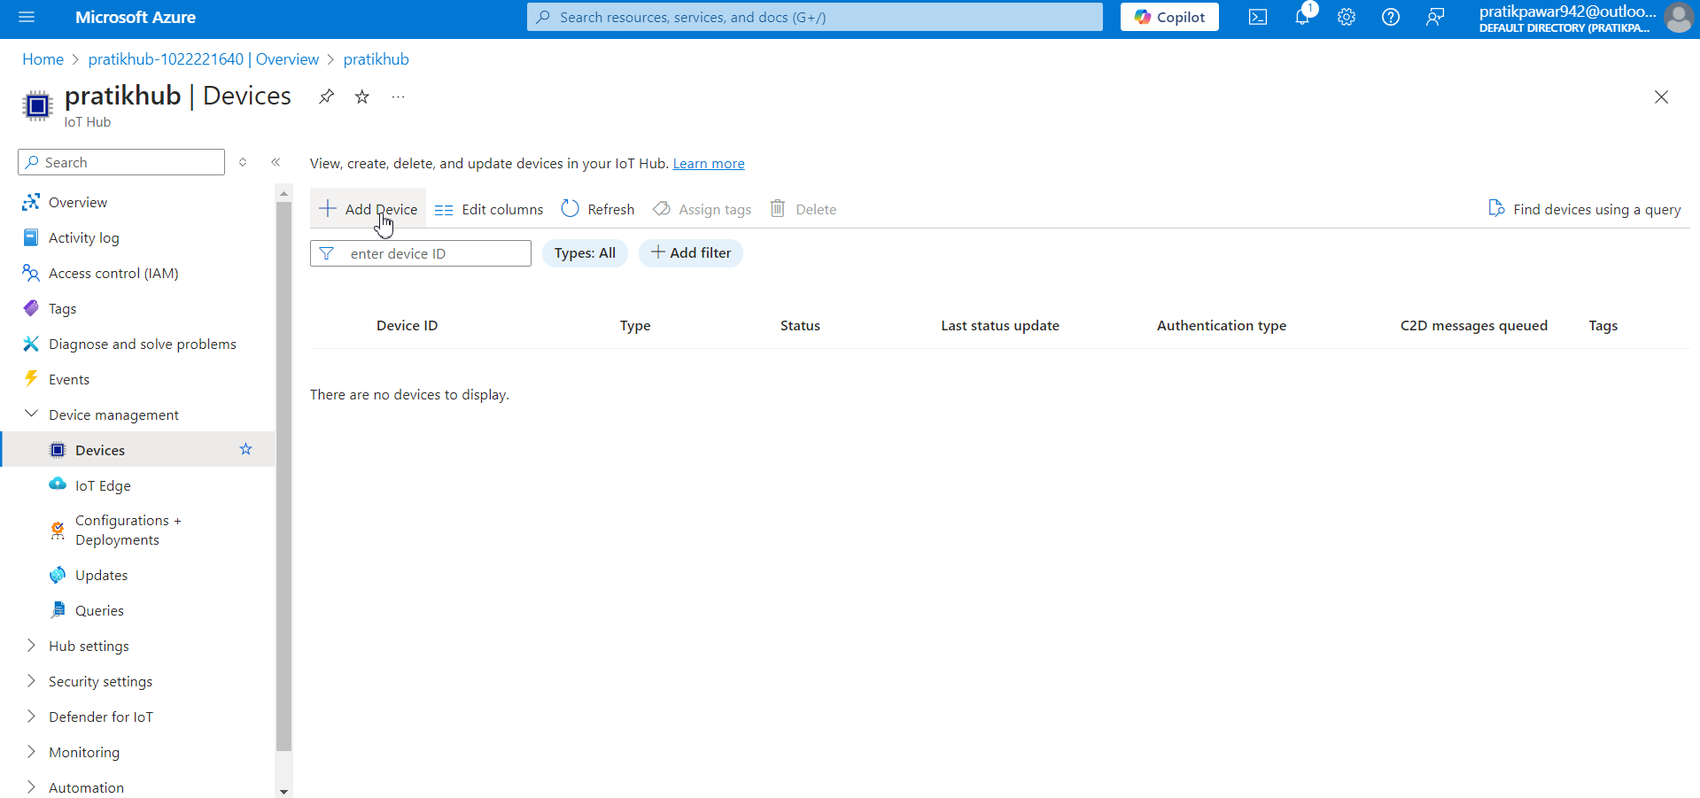
Add device

Slide 20
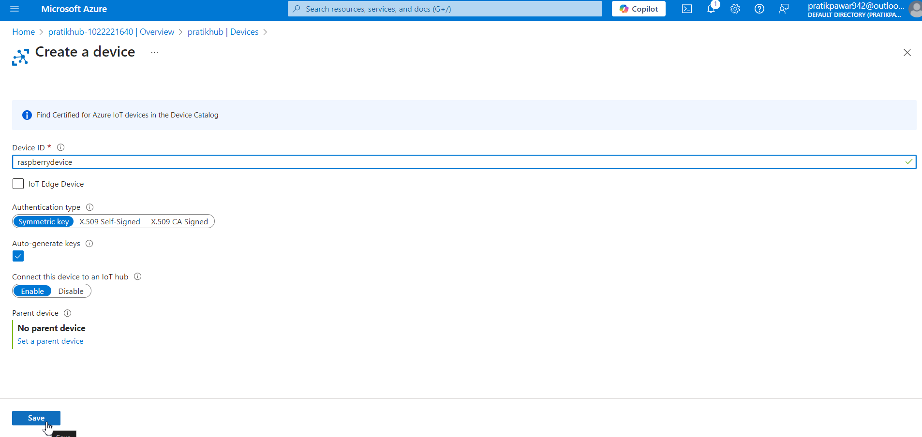
Give device ID as ‘raspberrydevice’ and save

Slide 21
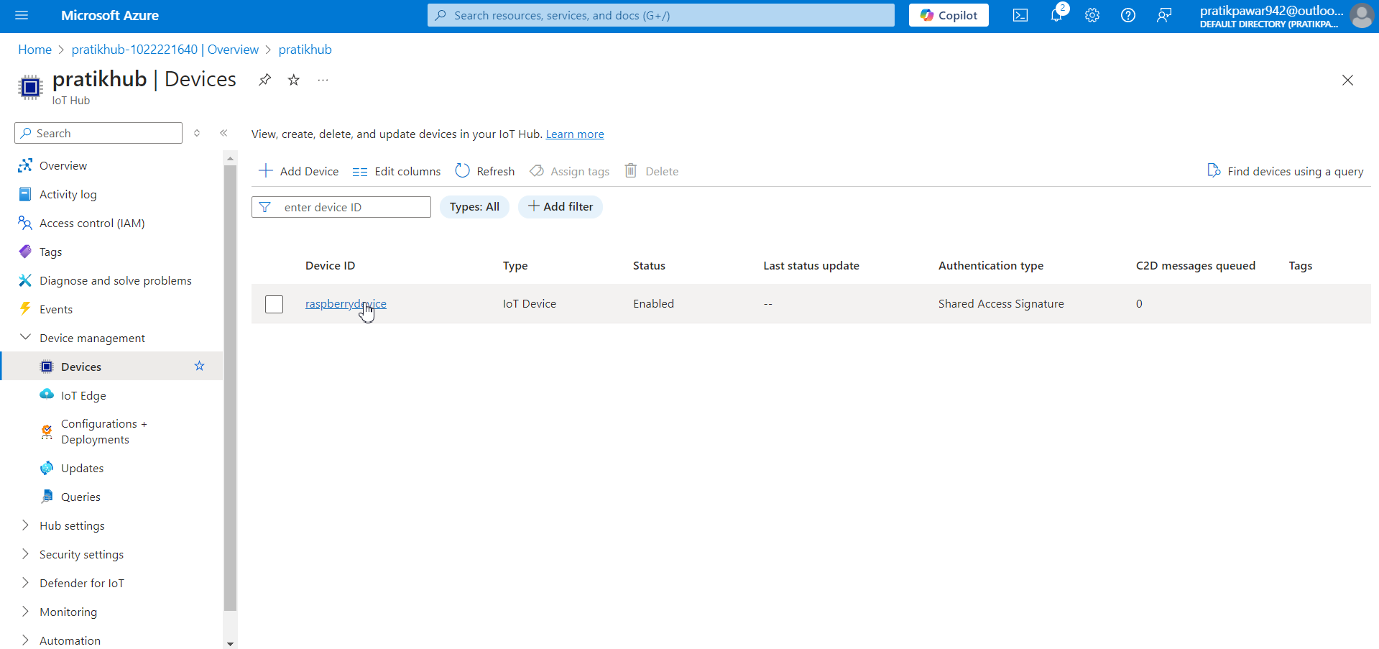
Now click on Device

Slide 22
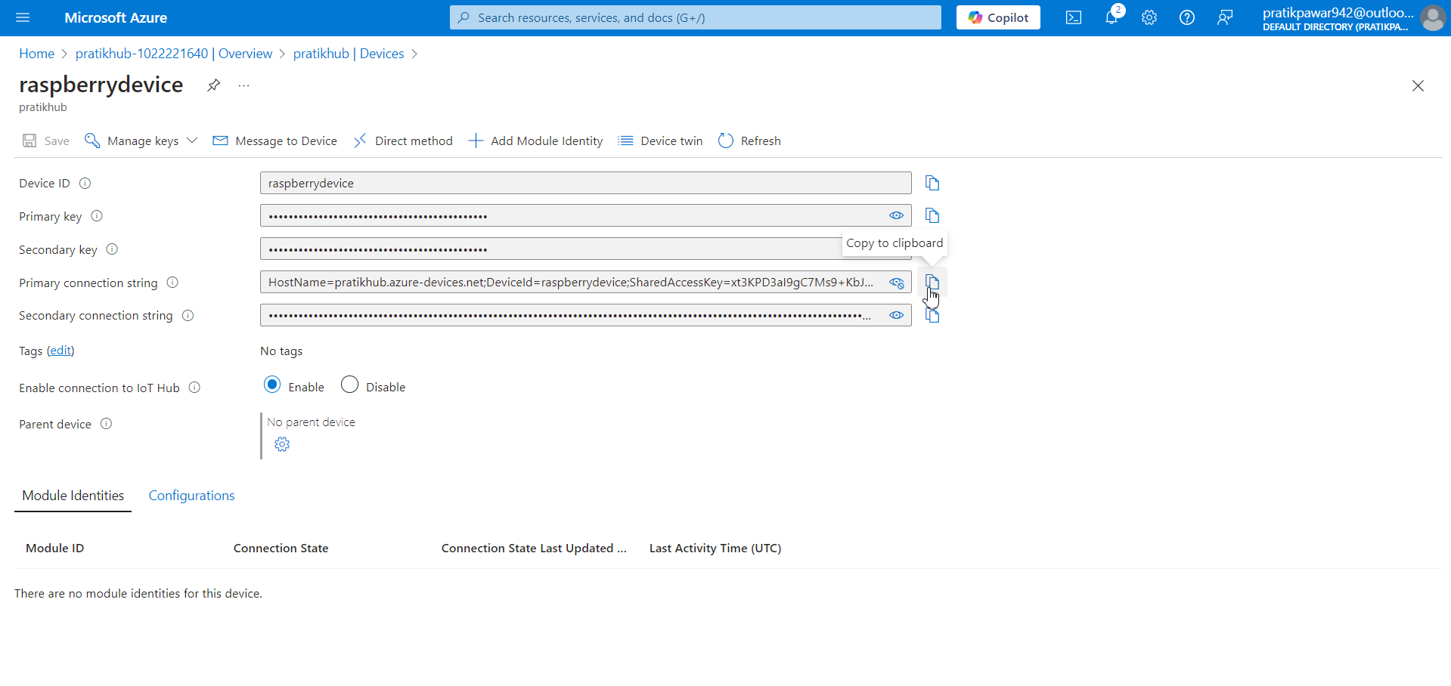
Now copy the primary connection string and psate in raspberry simulator for connection of device

Slide 23
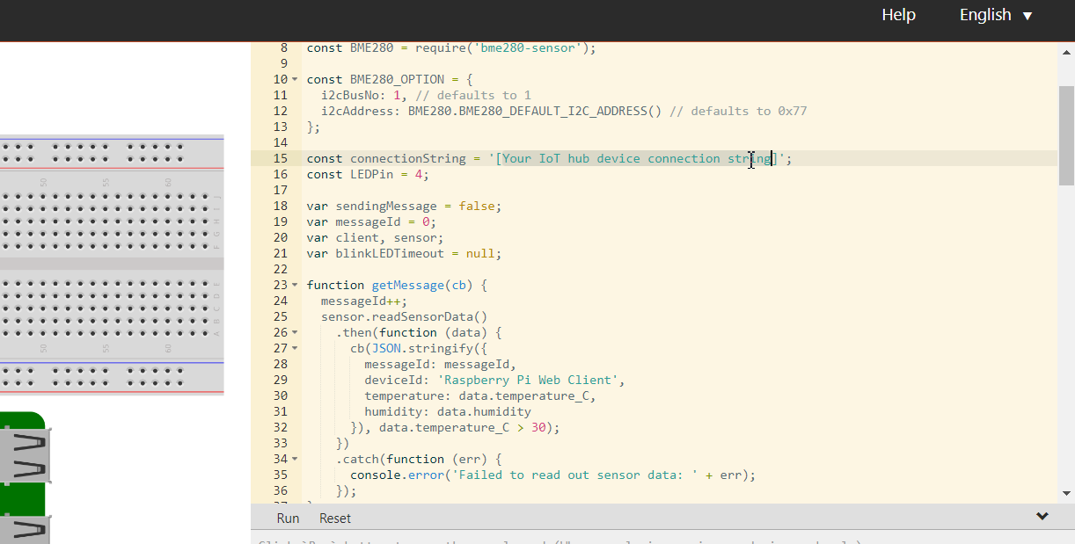
Now paste connection string in this code

Slide 24
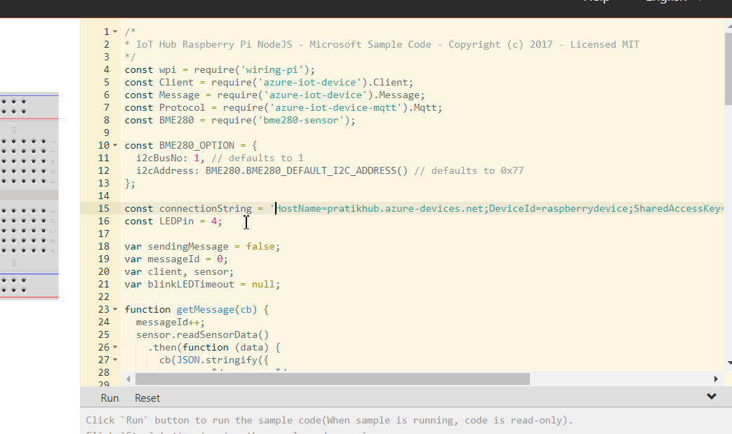
Also remove box brackets

Slide 25
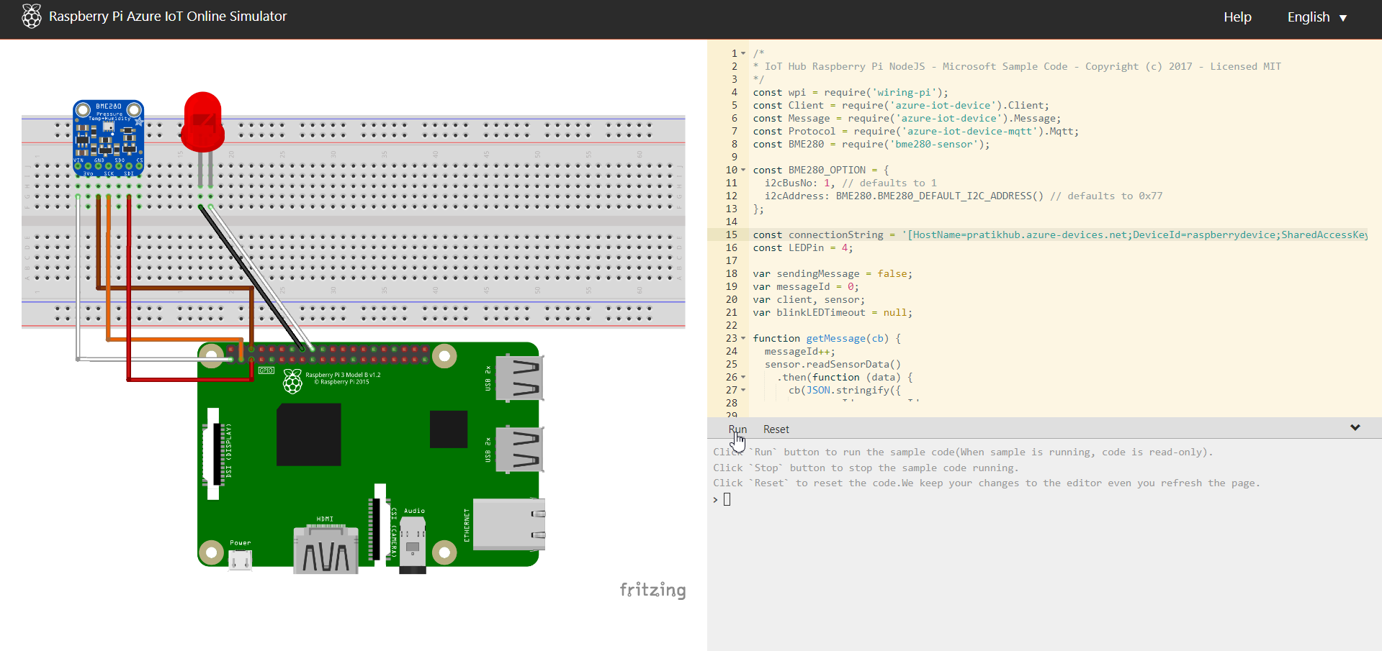
Run

Slide 26
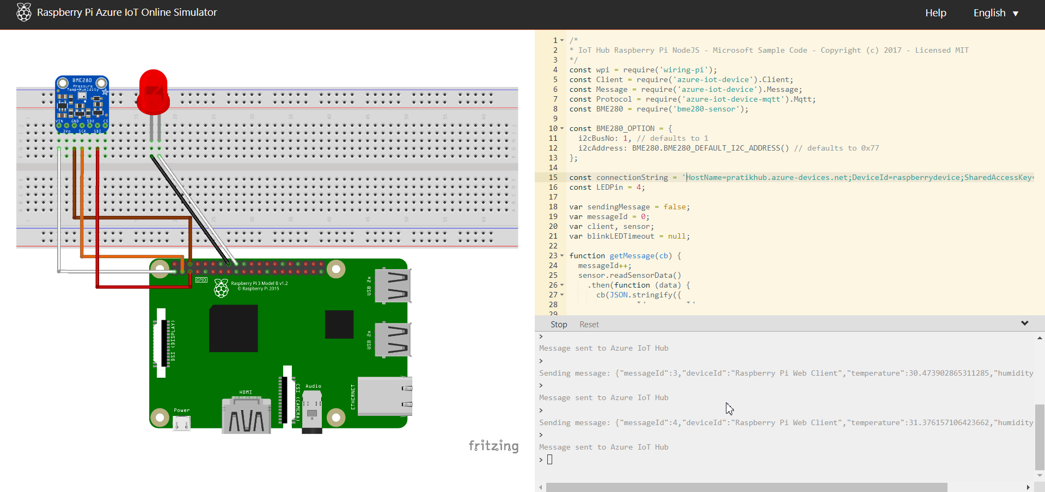
live data is generating now

Slide 27
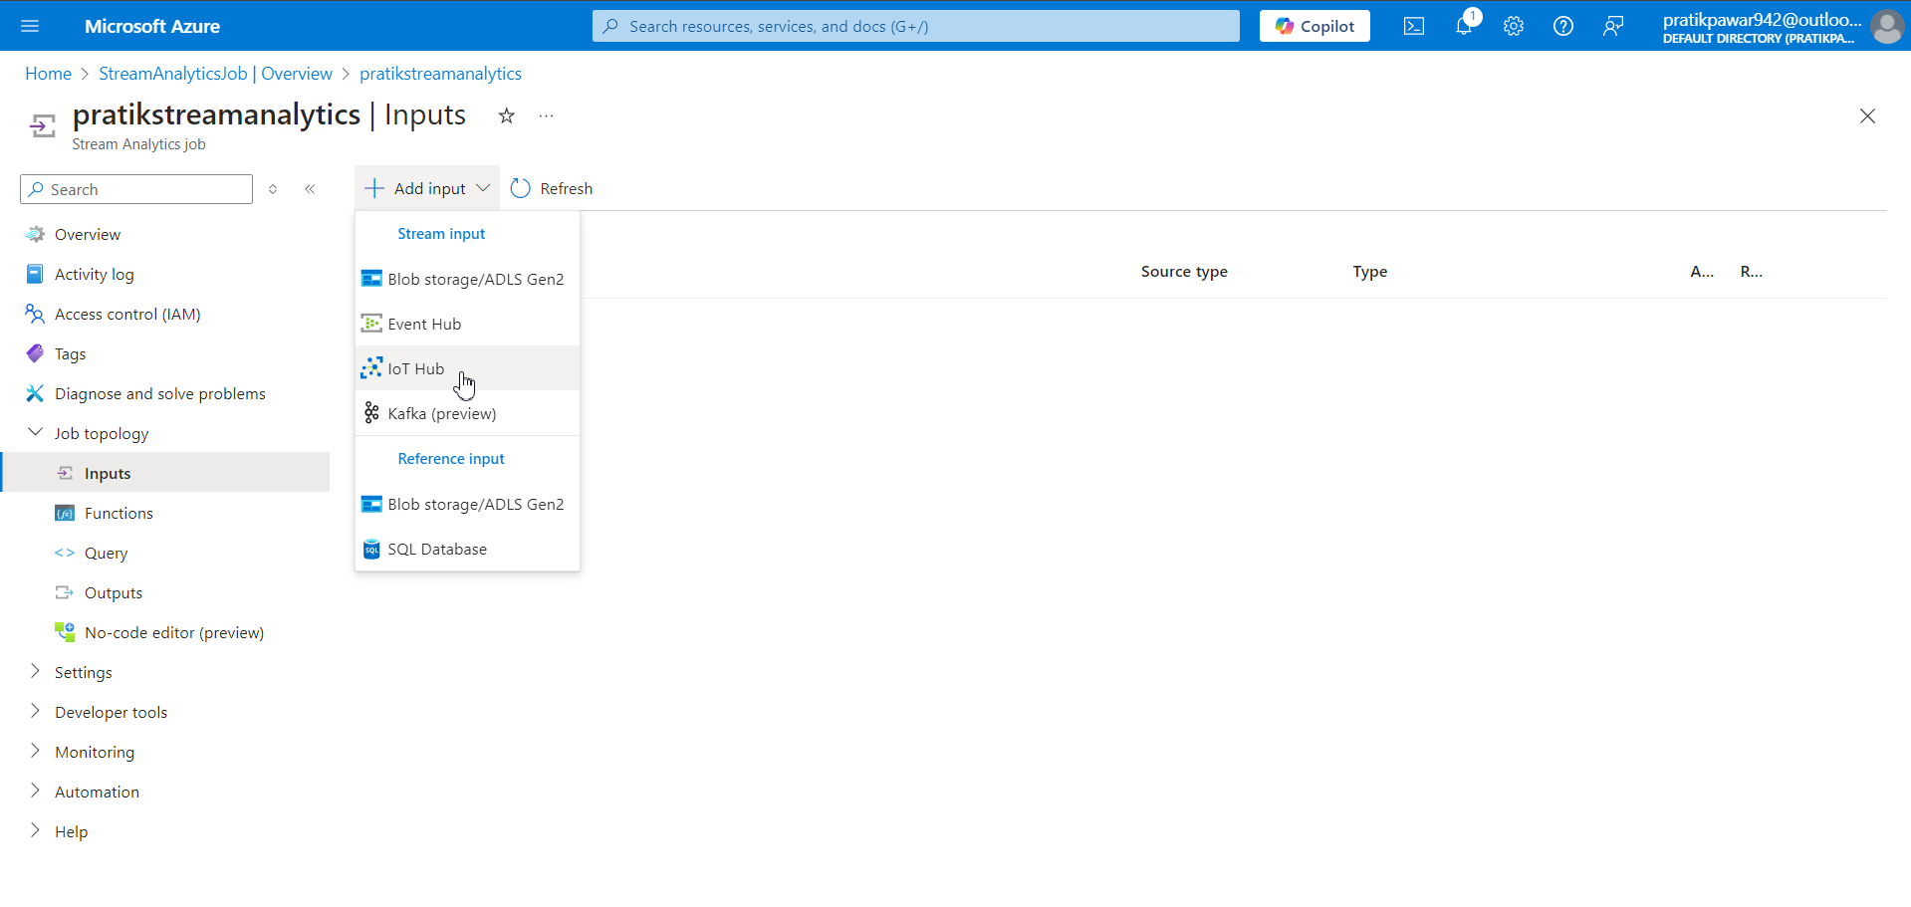
Now go to Stream > job topology > inputs > add input > Iot Hub

Slide 28
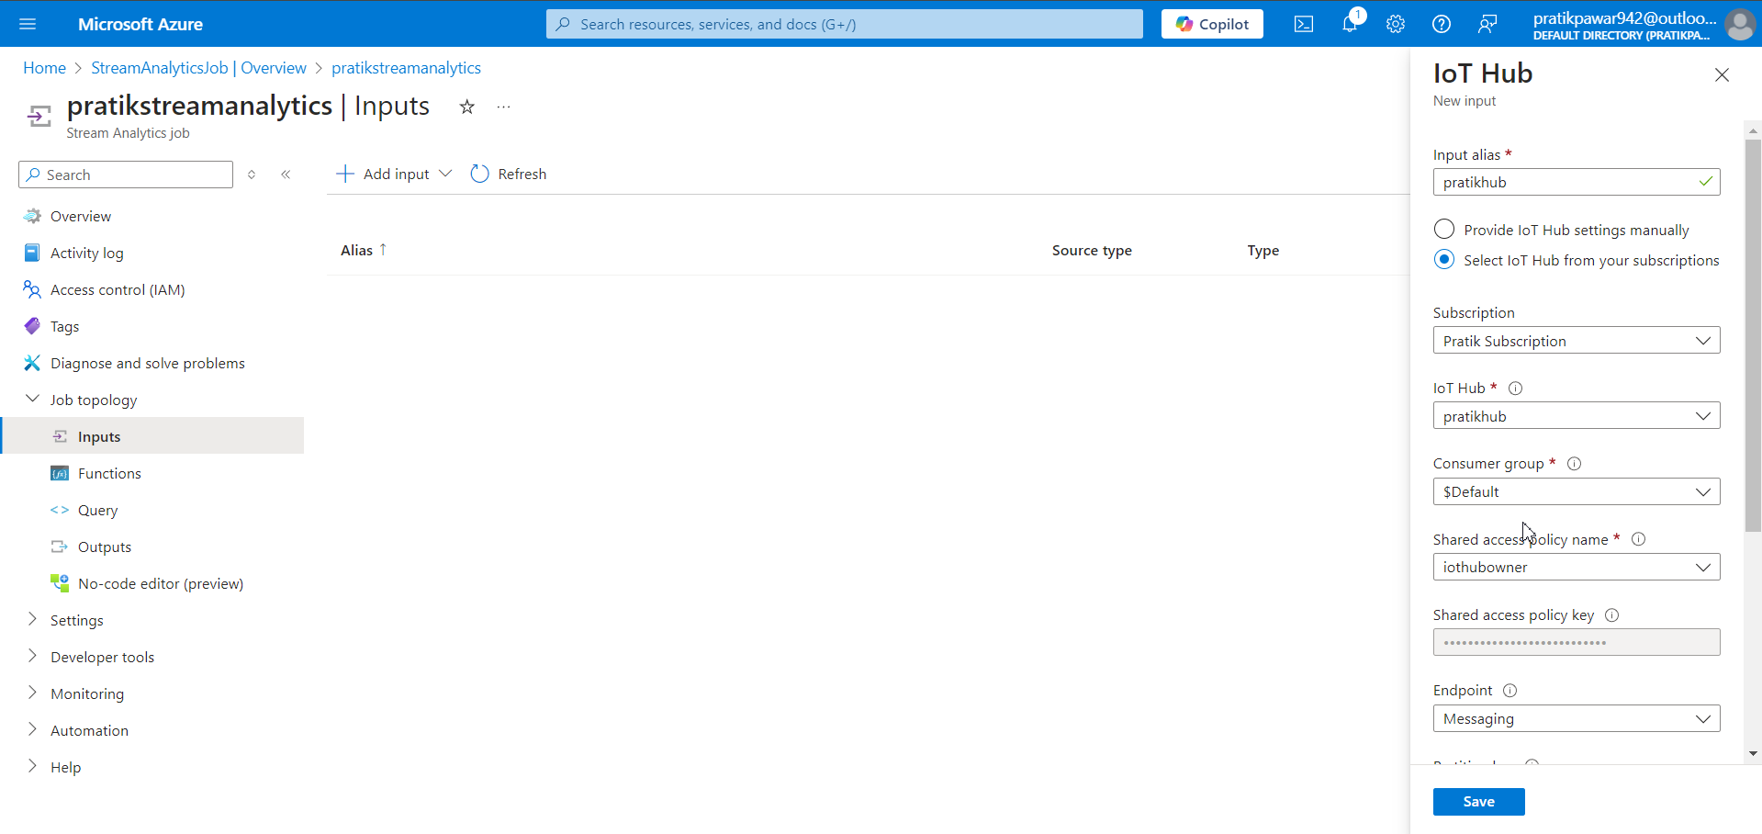
Automatically info is filled > Save

Slide 29
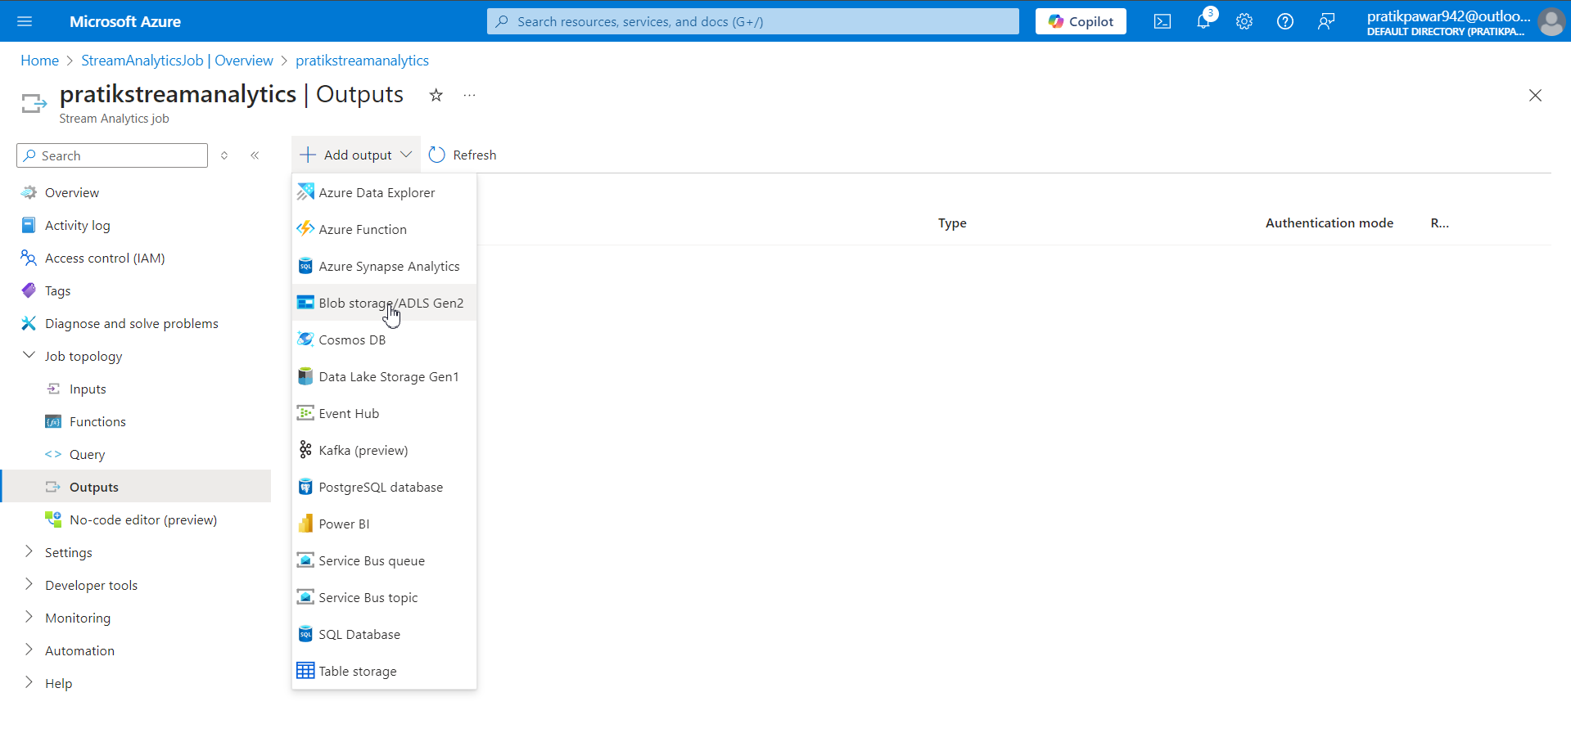
Now go to Output > Blob Storage / ADLS Gen 2

Slide 30
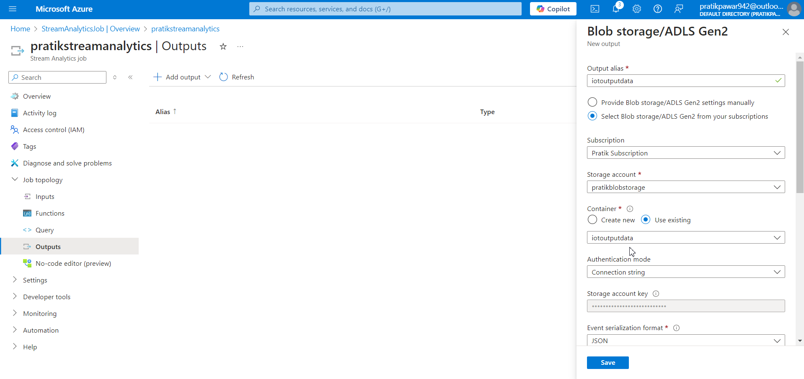
Info is filled automatically

Slide 31
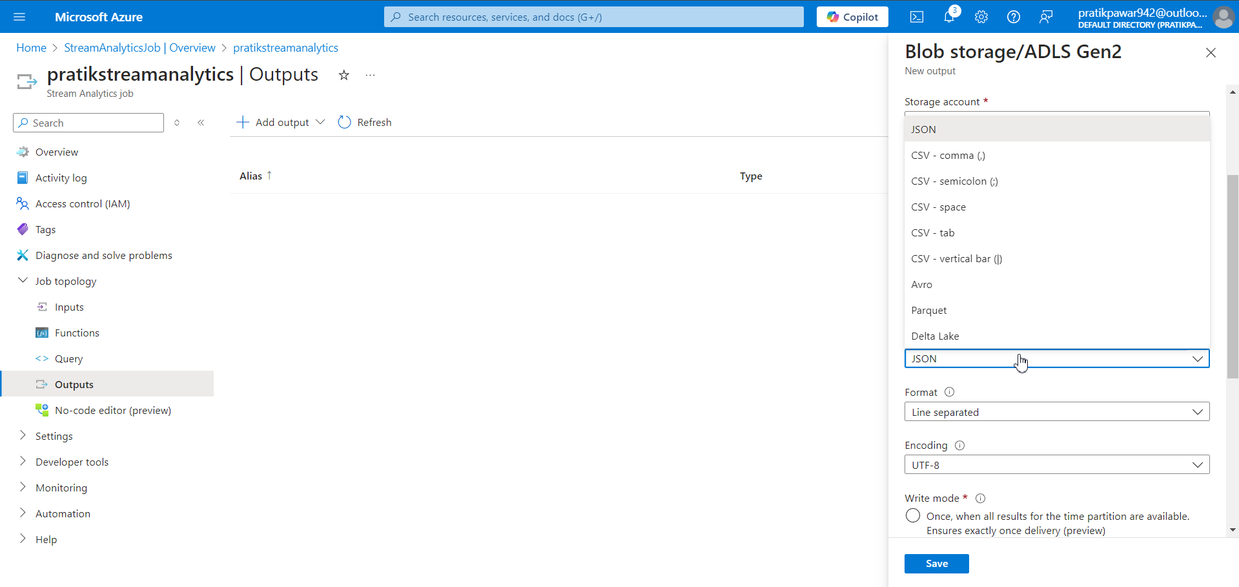
Select Output format

Slide 32
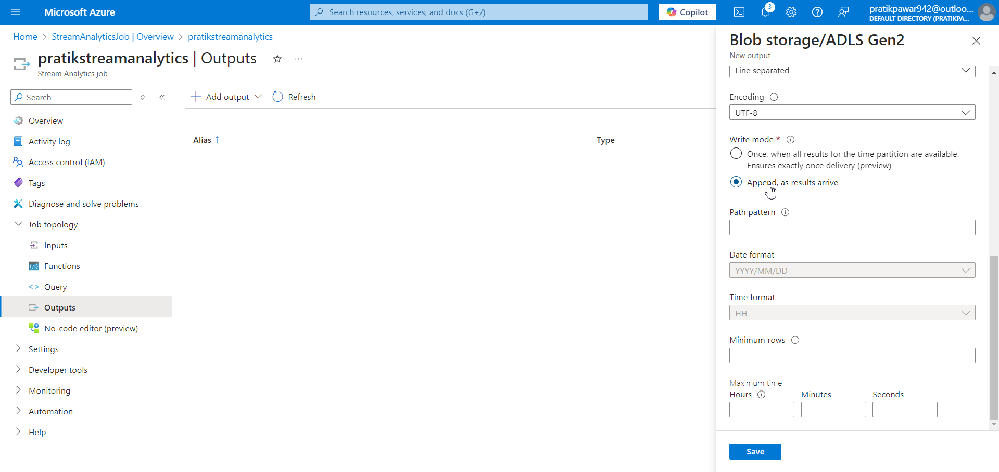
Check Append , as a result arrive(Data is load directly and not all at once) > Save

Slide 33
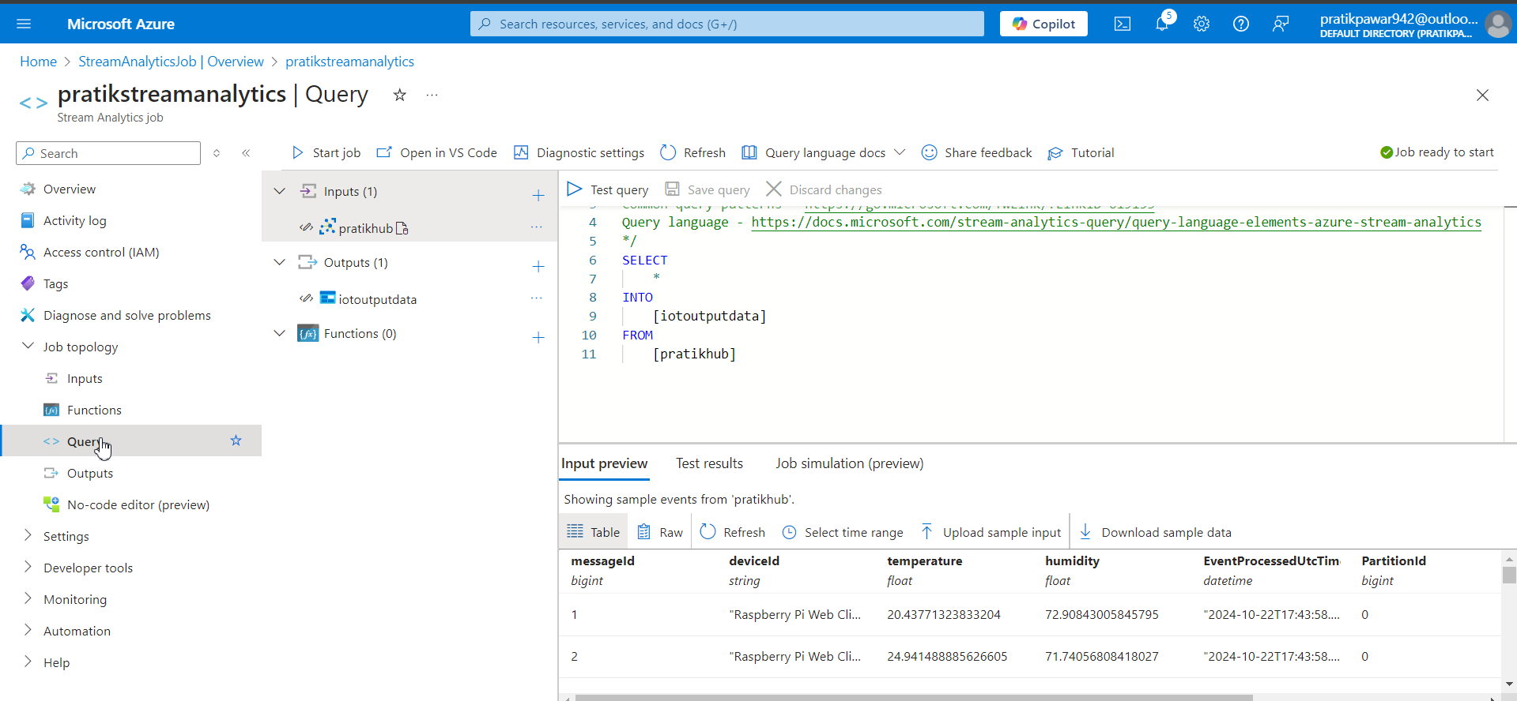
Go to Query ( Here we language similar to SQL is Used , we can changed the query so what output data we want)

Slide 34
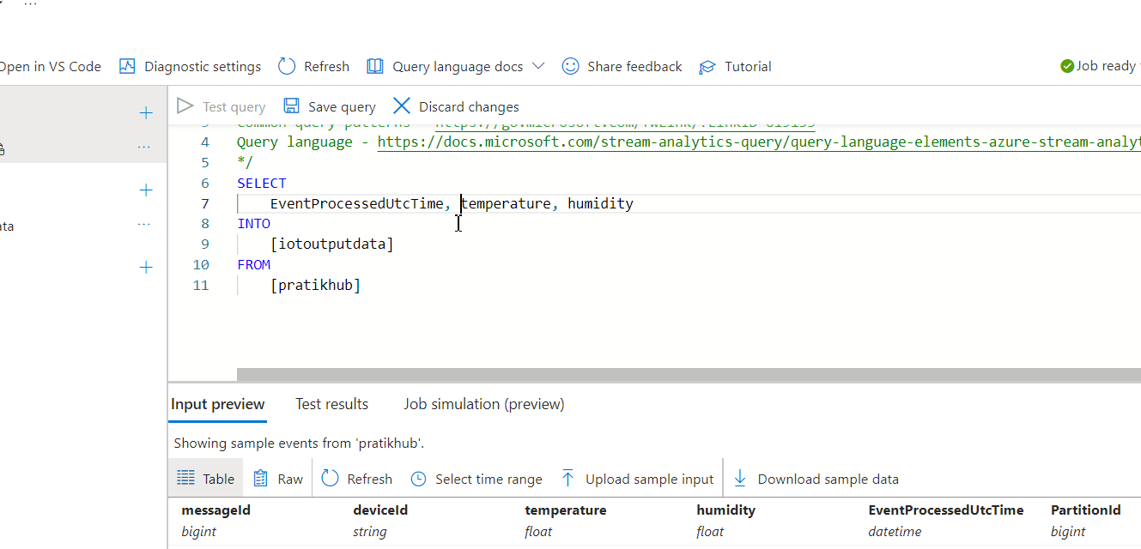
Type this three columns as requirement

Slide 35
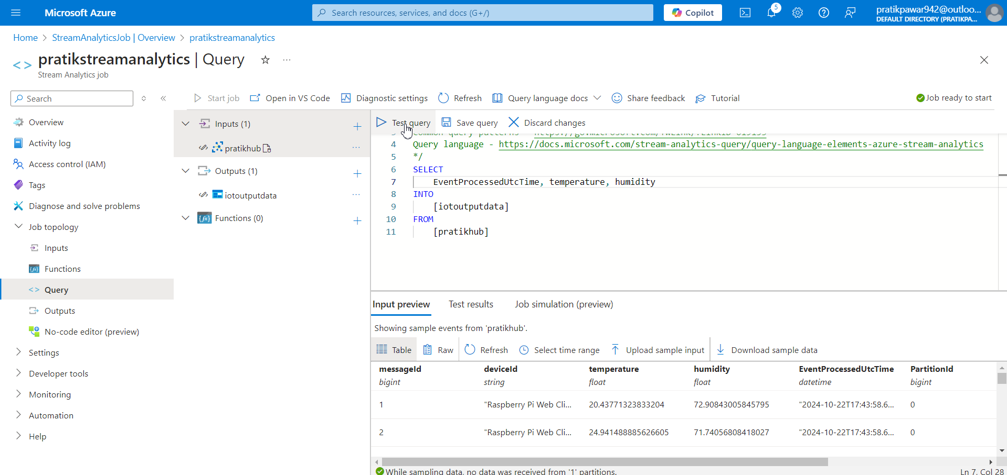
Test Query

Slide 36
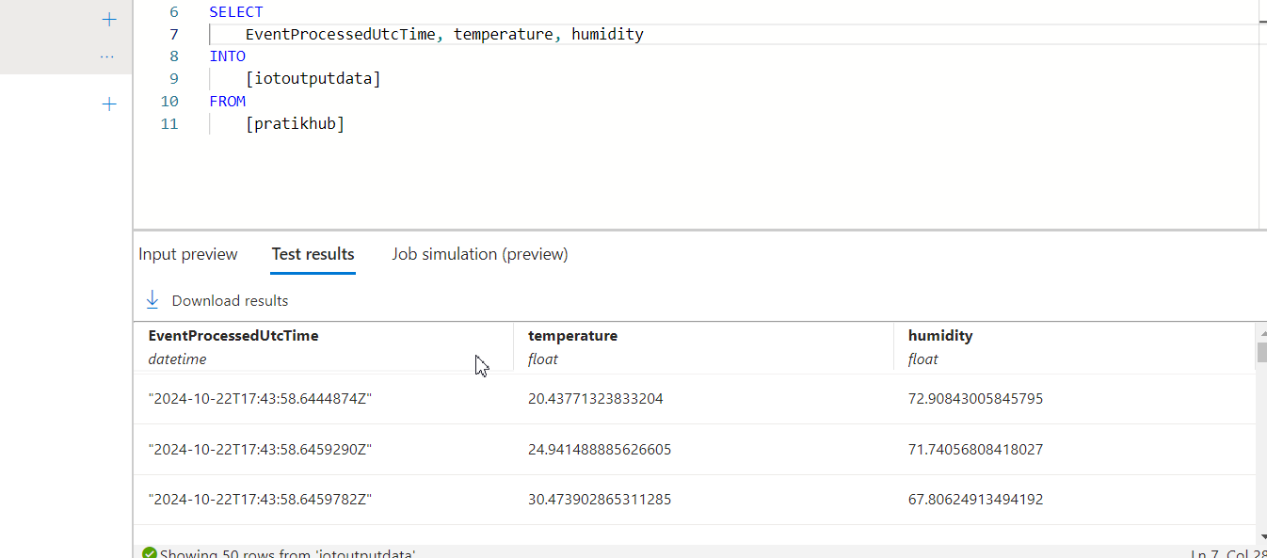
Here we can see the data we are going to get.

Slide 37
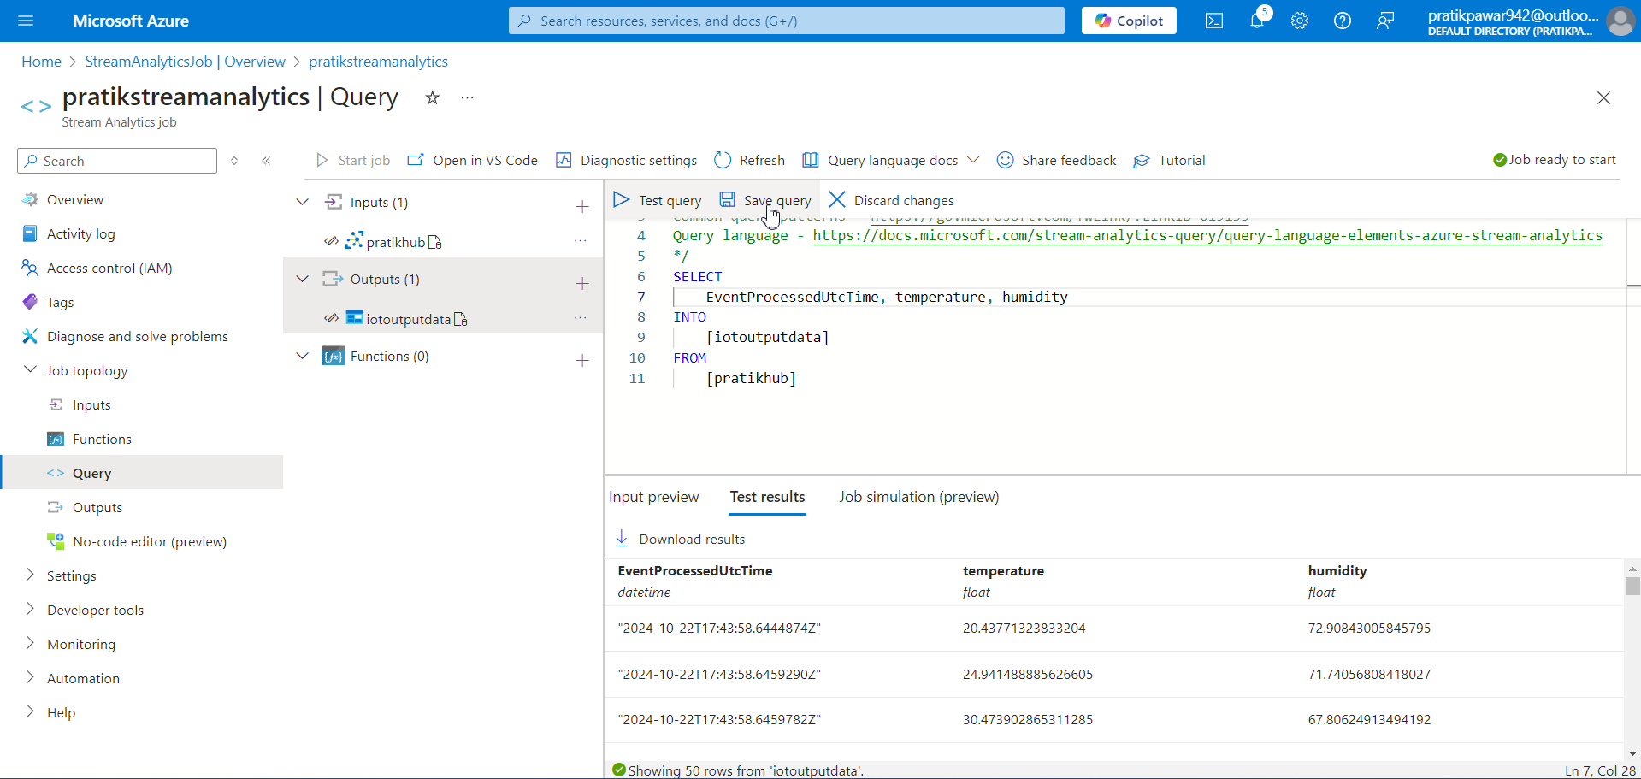
Now Save Query

Slide 38
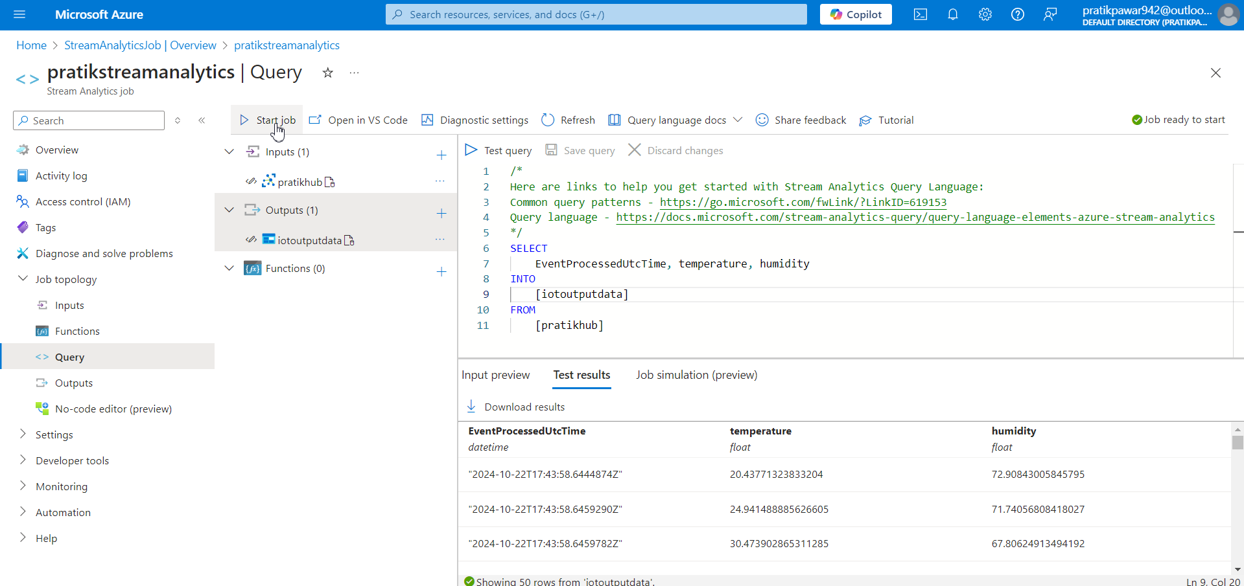
Start Job to capture live streaming data

Slide 39
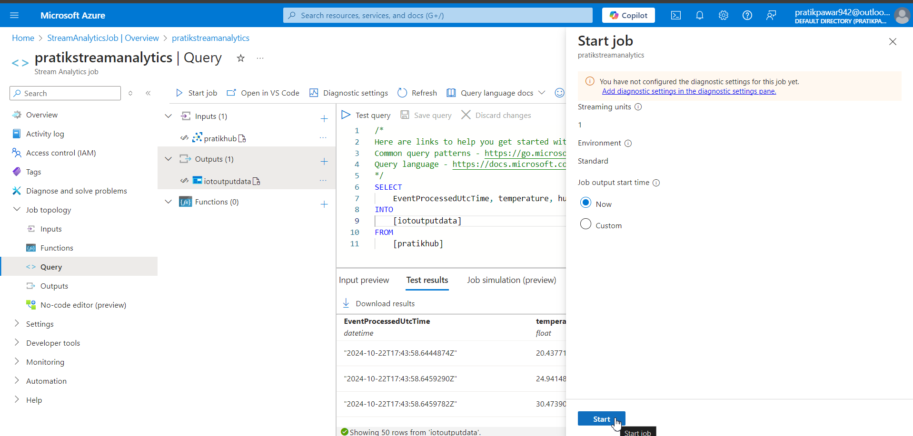
Start

Slide 40
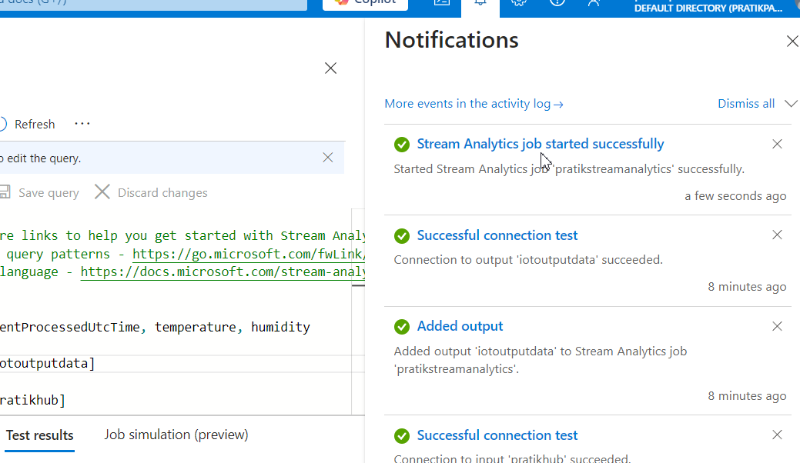
Stream analytics is successfully started

Slide 41
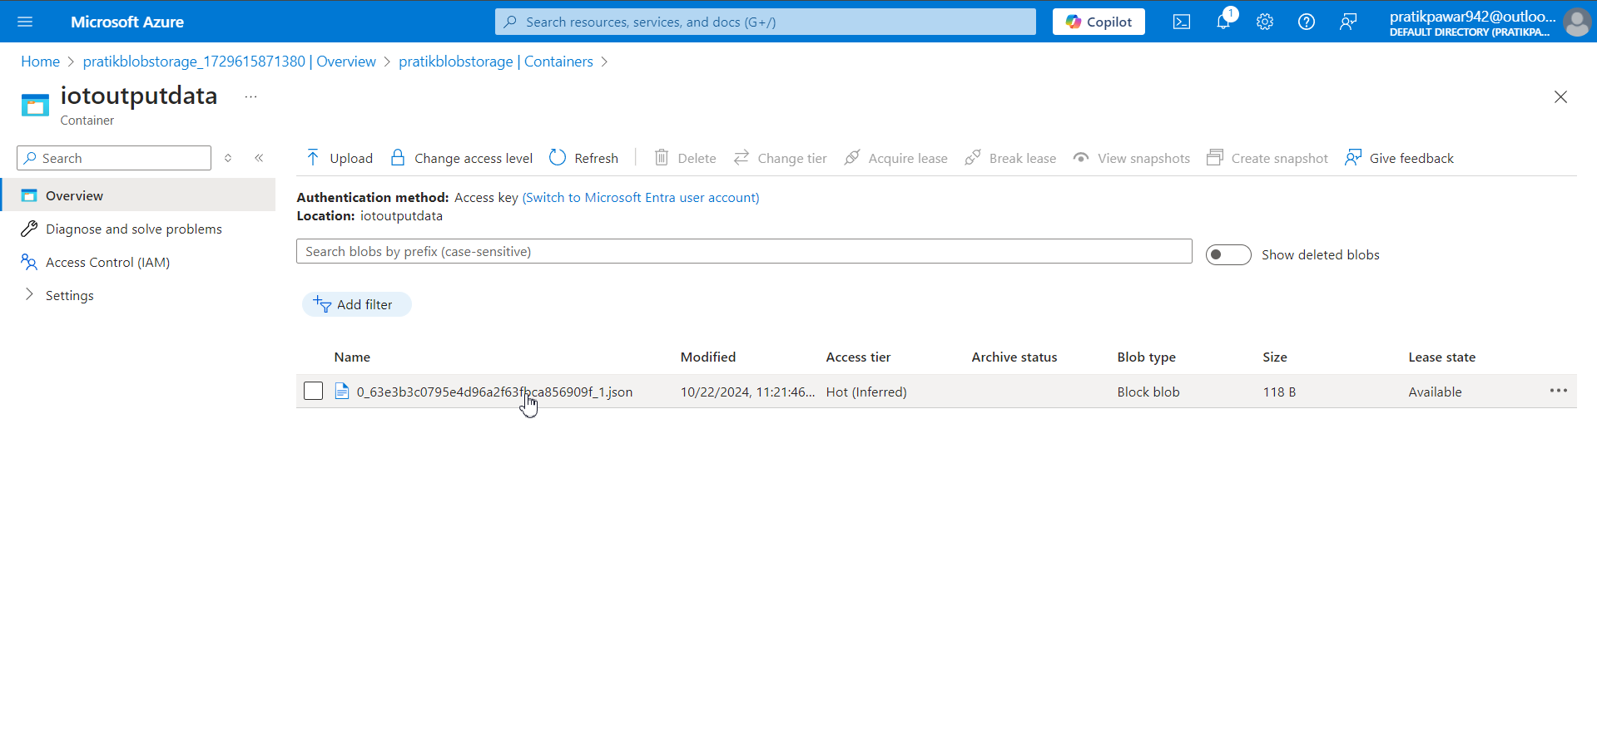
Now in Blob > Container > Live streaming data is storing

Slide 42
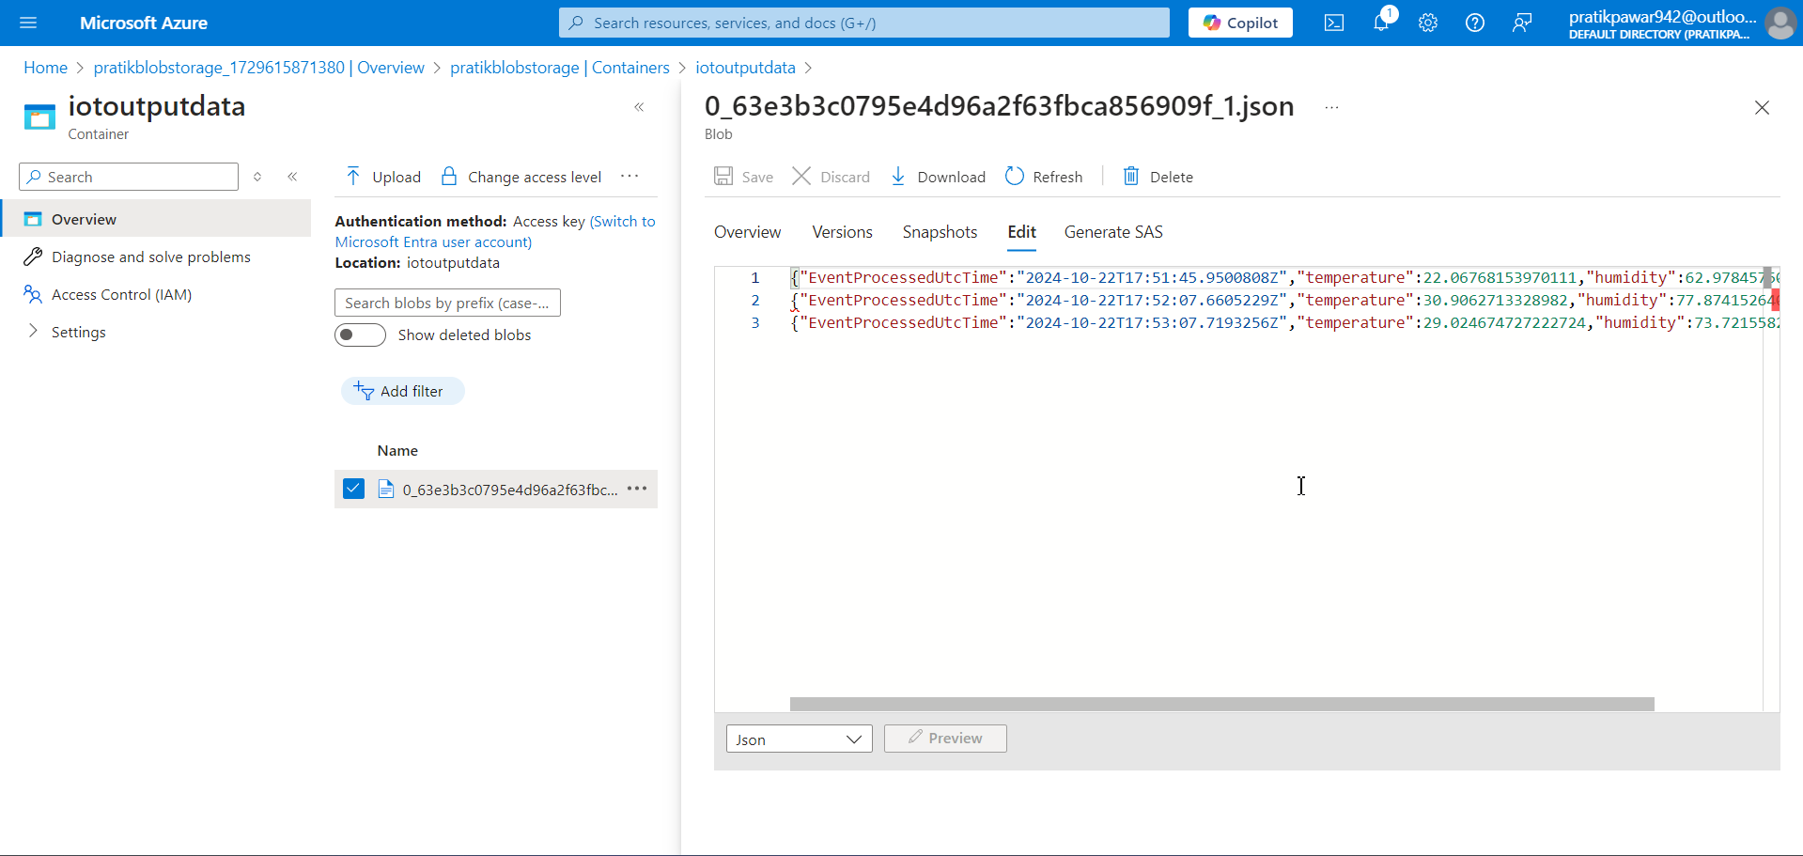
We can see the live streaming data is storing

Slide 43
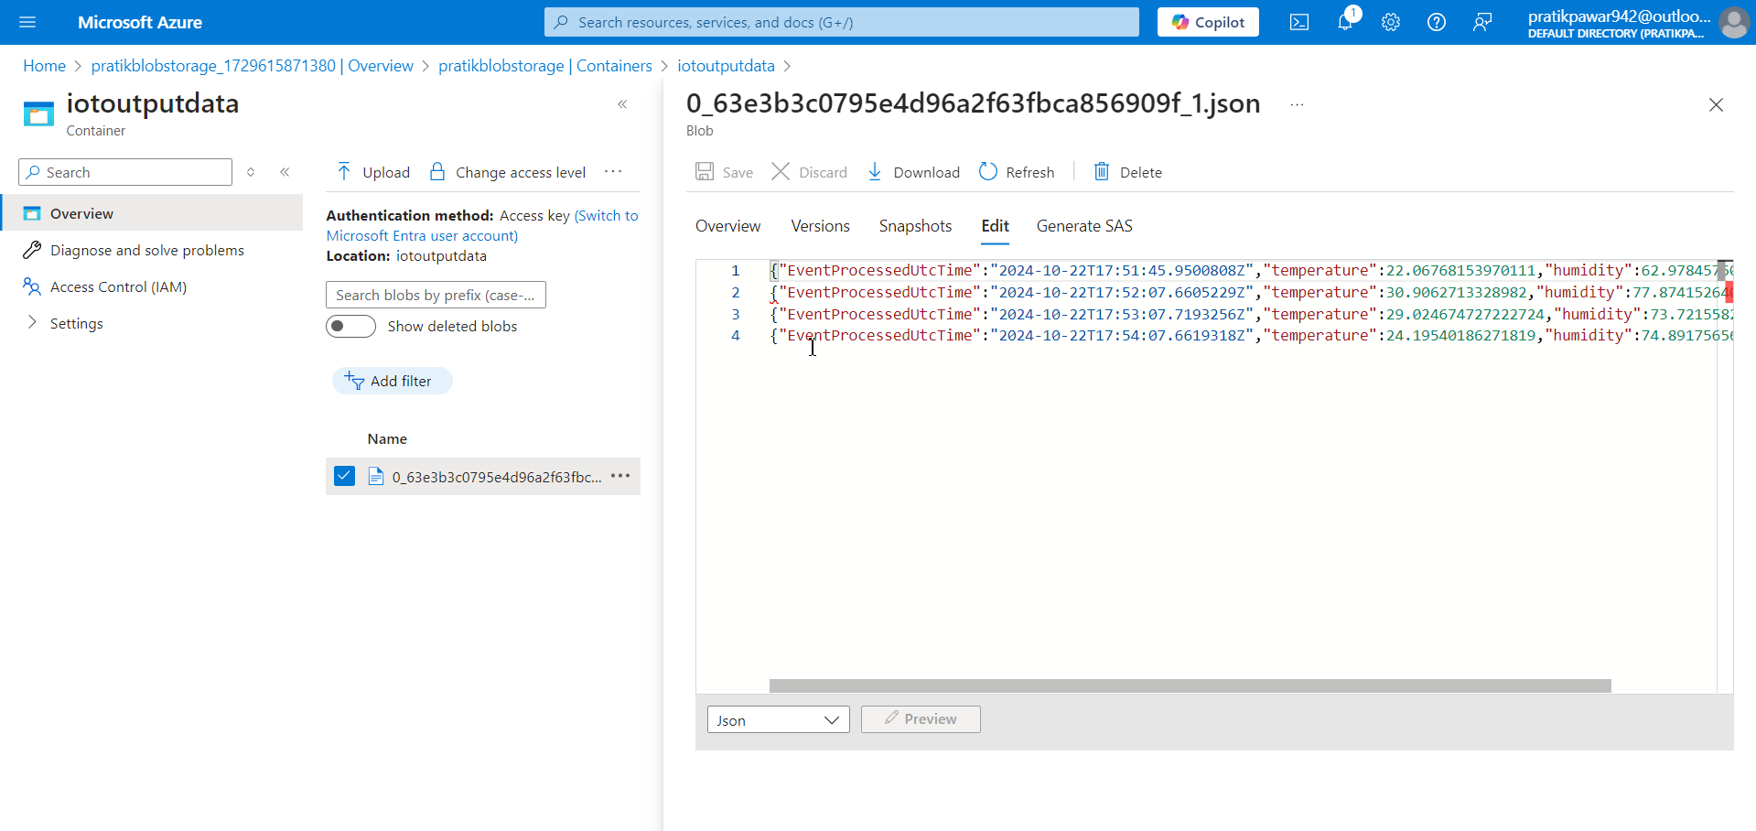
Here we can see that 4th data is recorded after 3rd Record.

Slide 44
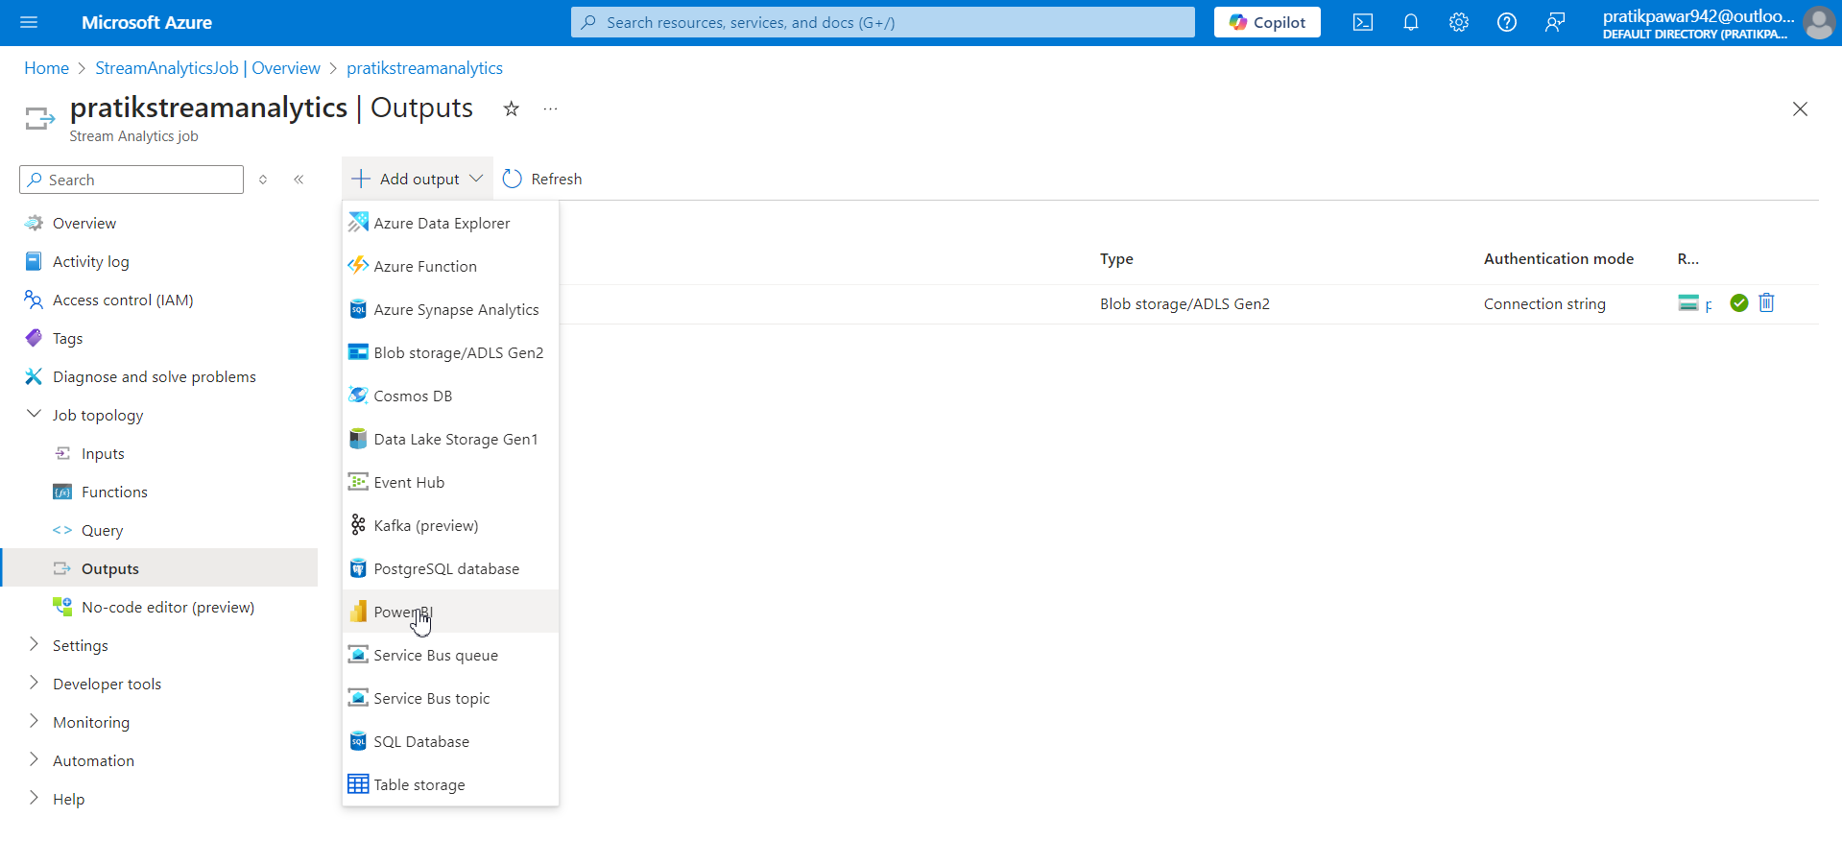
Also we can add output to PowerBi, So to see data in charts format in liv streaming.

Slide 45
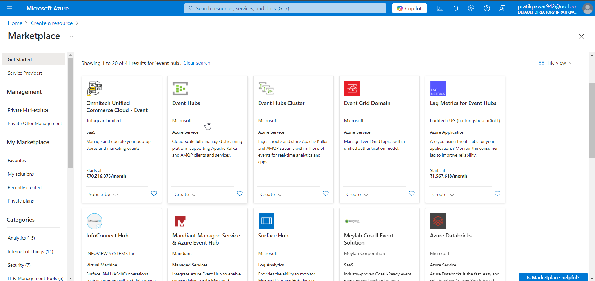
Also we can input live streaming data through event Hub or ADLS Gen2

